Slide 1
TOPIC Myriad Pro (Bold)40 PT
SUBTITLE Myriad Pro 30 pt

Slide 2
TITLE
TITLE
Grant/Research Support
  Consulting Fees/Honoraria
    Major Stock Shareholder/Equity
      Royalty Income
        Ownership/Founder

Slide 3
DISCLOSURE STATEMENT OF FINANCIAL INTEREST
Within the past 12 months, I or my spouse/partner have had a financial interest/arrangement or affiliation with the organization(s) listed below.
AFFILIATION/FINANCIAL RELATIONSHIP
Grant/Research Support
Consulting Fees/Honoraria
Major Stock Shareholder/Equity
Royalty Income
Ownership/Founder
Intellectual Property Rights
Other Financial Benefit
COMPANY
Company One
Company Two
Company Three
Company Four
Company Five
Company Six
Company Seven
Company Eight

Slide 4
DISCLOSURE STATEMENT OF FINANCIAL INTEREST
I, (insert name) DO NOT have a financial interest/arrangement or affiliation with one or more organizations that could be perceived as a real or apparent conflict of interest in the context of the subject of this presentation.

Slide 5
TEXT SLIDE – TITLES
Red text can be used as a highlight color
  No text shadows on any text
Italics are better to emphasize words rather than underline
Line spacing should be 1 Line with 0.3 before each paragraph
Set the slide transition to wipe right
Remove unnecessary animations

Slide 6
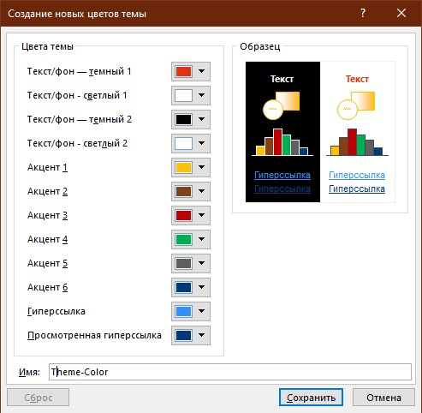
COLOR PALETTE
Use these colors to format all elements in the file including charts, graphic elements and tables

Slide 7
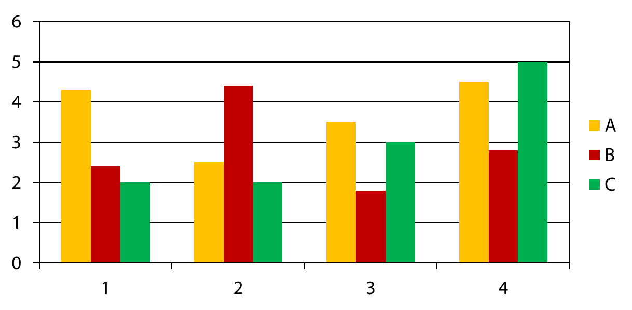
CHARTS SLIDE
Subtitle text 20 pt.

Slide 8
TABLE SLIDE
Subtitle text 20 pt.
 | DCA n = 381 | Stent n = 372 | P Value
Late loss (mm) | 25.0 | 13.0 | 0.28
Binary restenosis | 26.7 | 22.1 | 0.24
- Optimal DCA (%) | 16.2 | 22.1 | 0.39
- TVR | 25.0 | 23.0 | 21.0
12-Month TVF (death, MI, TVR) (%) | 23.9 | 21.5 | 0.48

Slide 9
SAMPLE ORG CHART
139 patients enrolled between July and December 2004 in 13 clinical sites in Europe, South America and New Zealand
DESIGN
DESIGN: Prospective, non-randomized, single-arm, multi-center clinical evaluation of the AXXESSTM Plus Bifurcated Coronary Stent System
OBJECTIVE: To evaluate the acute and long-term safety, tolerability and performance of the AXXESS Plus stent
PRINCIPAL INVESTIGATOR Eberhard Grube, MD Helios Heart Center,Egburg, Germany
3 patients not stented
136 patients with AXXESS conical stent implanted
Clinical follow-up at 6 months in 99.3% (N=135)
Angiographic follow-up at 6 months in 92.6% (N=126)
Clinical follow-up at 12 months in 96.3% (N=131)

Slide 10
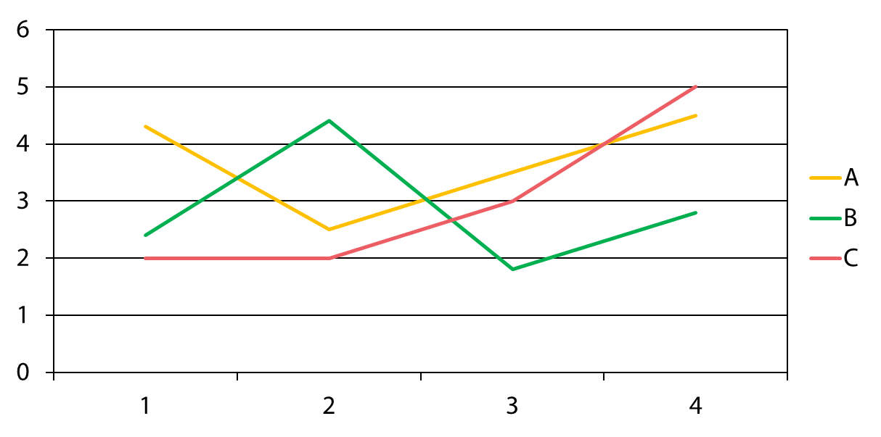
SAMPLE LINE CHART
Subtitle text 20 pt.

Slide 11
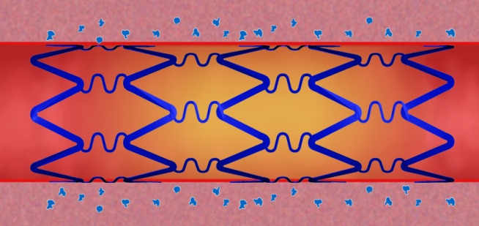
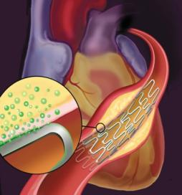
PHOTOS & BULLETED TEXT
Text here
Text here
Text here
Text here
Text here
Text here

